Slide 1
Interview Question Portal
Subject : Advanced Database Management System
Name : Sanika Sambhaji Bhagat

Slide 2
Purpose
The interview question portal will help the students to get all the necessary help that they need for their interviews.
This portal can be used by the students :
To post some interview questions that are worthy to be shared with other students
View some interview questions to prepare well for the interview
Post doubts which can be answered by the subject faculty
View some last minute interview tips and tricks

Slide 3
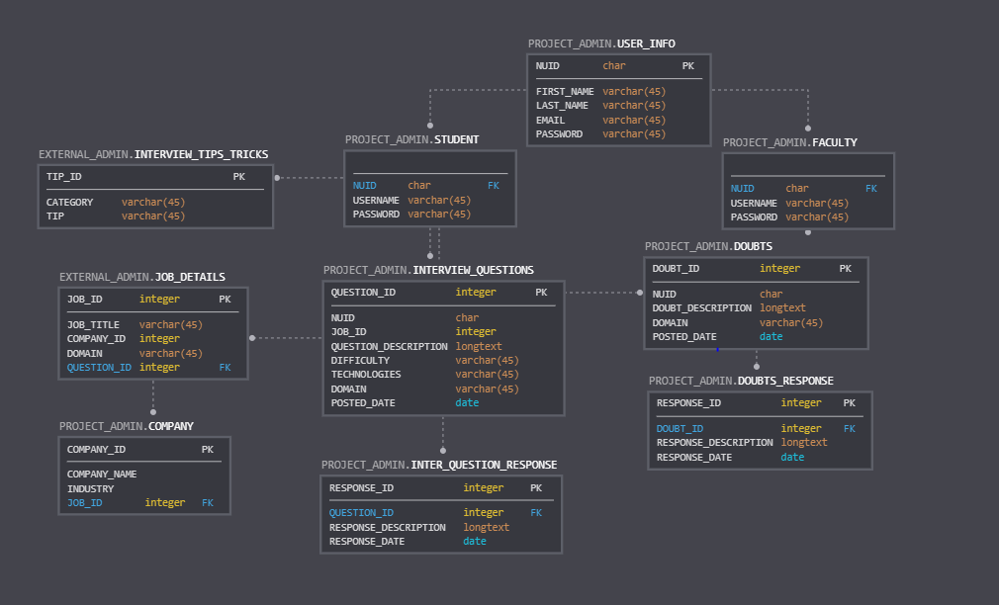
ER Diagram

Slide 4
Use Cases
Post Interview Questions
Post Doubts
View Interview Questions
View Interview Questions posted by user
View Doubts posted by User
View Responses to Interview Questions
View Responses to Doubts
Post Response to Interview Questions
View Interview Tips and Tricks
Post Responses to Doubts
View Doubts

Slide 5
Features Used
User input (‘&’)
Pragma exceptions, pre-defined exceptions
Triggers on log on schema, DML to populate log tables
Conditional statements
Procedures
Functions
Regexp
Collections (Varray, Record)
Cursors
External Tables
PDB and CDB
Data Loading by SQL Loader
Views
APEX Application
Creating users and granting privileges

